Slide 1
RSE consultation
2019/2020

Slide 2
Quick starters: sexeducationforum.org.uk
- 78% of parents want primary schools to teach their children about the difference between safe and unwanted touch and how to speak up if someone treats them inappropriately
- 72% of parents think primary schools should teach children about what to do if they find pictures showing private parts of the body online or are asked to send them.
- 92% of parents support the teaching of PSHE education (which includes lessons about staying safe from abuse) in all schools (YouGov poll, PSHE Association, 2016)

Slide 3
Quick starters: sexeducationforum.org.uk
“…research tells us that children and young people want their parents to be their primary educator in this field.”
However…
“Young people say that school is their preferred first choice for RSE, followed by their parents, but currently many parents are falling short in providing RSE at home:
- For boys, the main source of sex education while growing up is school (39%), followed by friends (24%), with fathers accounting for 3% and mothers 4%.”

Slide 4
Quick starters:
People aged 16 to 24 years were most likely to identify as LGB in 2017 (4.2%).
According to the Department for Education, primary schools will be “encouraged to cover LGBT content if they consider it age-appropriate to do so, but there is no specific requirement for this.”

Slide 5
What is RSE?
Relationships and Sex education
Relationships, friendships, families, growing up, compromise and problem solving, self esteem, puberty, reproduction, anatomy, sexuality, gender, consent etc
What can you remember from your own RSE?

Slide 6
What the law says
Statutory teaching from Sept 2020
Parents have the right to request their child is excused from some of the content
Science curriculum content is statutory
Health education content is statutory – menstrual health, puberty etc. from 2020

Slide 7
What we say
Essential to prepare children for life as a teenager and beyond, living with a diverse group of people
Essential to prepare children for mutually fulfilling relationships based on trust, respect and consent
Essential to prepare children for the changes that will inevitably happen to their bodies at various times
Essential understanding to protect them against potential abuse in all its forms

Slide 8
Our programme of study
Browse the programme of study for our schools –
Surprises?
Comments?
Questions?

Slide 9
Norfolk Educator Solutions resource
Images are realistic
Tasks are fun and interactive
Tasks are for both boys and girls
Tasks and images represent difficult cultures and differently-able people – especially good for children in our communities who do not experience much diversity.
Stereotypes are deliberately avoided/taught out.

Slide 10
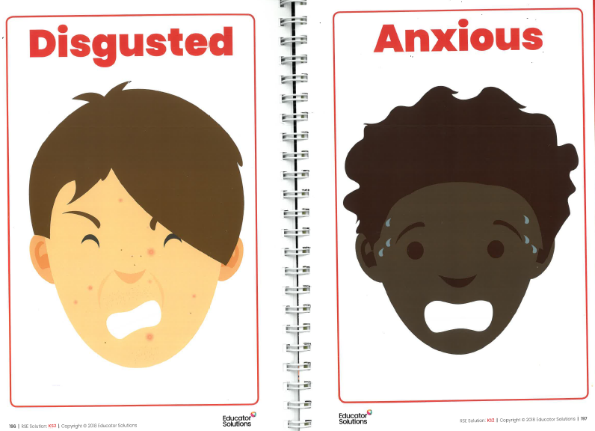
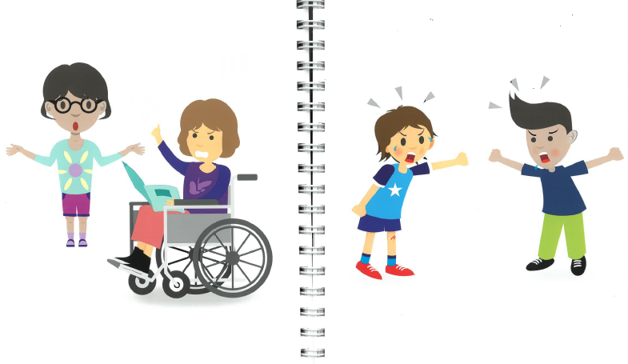
Images are representative of a range of normal people, with puberty-related skin and all sorts of hair cuts!
The images also show people who are differently able, and that ANYONE can be in the wrong.

Slide 11
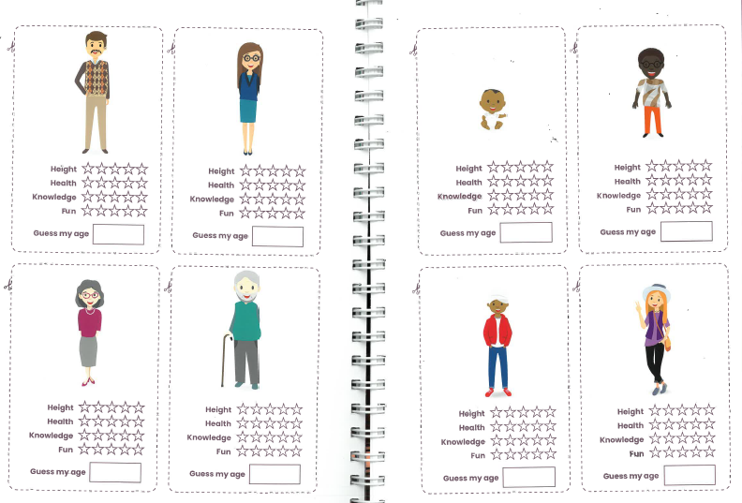

Slide 12
Boys/girls/SEN?
Inclusive of all, at the appropriate level
Dissipates problems of gender or sexuality, as teaching caters for all
Helps to create open discussion across sexes – some single parents families can find some discussions more difficult depending on the sex of the child
Specific boy/girl talks for questions and clarification, though children very rarely feel differently about asking in front of girls or boys.
Consent does not depend on gender or sex. By teaching all together, it re enforces the equality of message.
Consent and content also applies to those who are differently able or have SEN. Some children may need content adjusted to be stage appropriate.

Slide 13
Keeping people safe
Questions can be anonymous
Questions are impersonal and can be hypothetical
We have vocabulary guides for staff to work with to ensure we have the correct and appropriate vocabulary for these lessons
Safeguarding principles are still at the heart of school – this is made very clear to children – so disclosure or concern is managed in the same way as it would be outside of RSE.

Slide 14
What things are pertinent for your child?

